Slide 1
Fundamentals of AI/ML
A detailed and In-depth Overview
By Amandeep Singh Reen - SME(Data and AI)

Slide 2
Index of the Series
Various Types of Dataset (Mathematical interpretation)
Ingestion of Data from various Data-points
Choosing a Model
Implementing model with best practice
Overcoming Training issues
Adding weak learning or strong learners selection techniques (Boosting and Bagging)
Evaluation and business value

Slide 3
Various Types of Dataset (Mathematical interpretation)

Slide 4
Why Data Verification Matters
Data is the backbone of IT systems
Errors → security breaches, compliance failures, poor decisions
Example: Duplicate financial transactions → monetary loss

Slide 5
Types of Datasets in IT
Structured: Databases, tables, logs
Semi-structured: JSON, XML, NoSQL
Unstructured: Text, images, sensor data
Streaming: IoT feeds, real-time logs

Slide 6
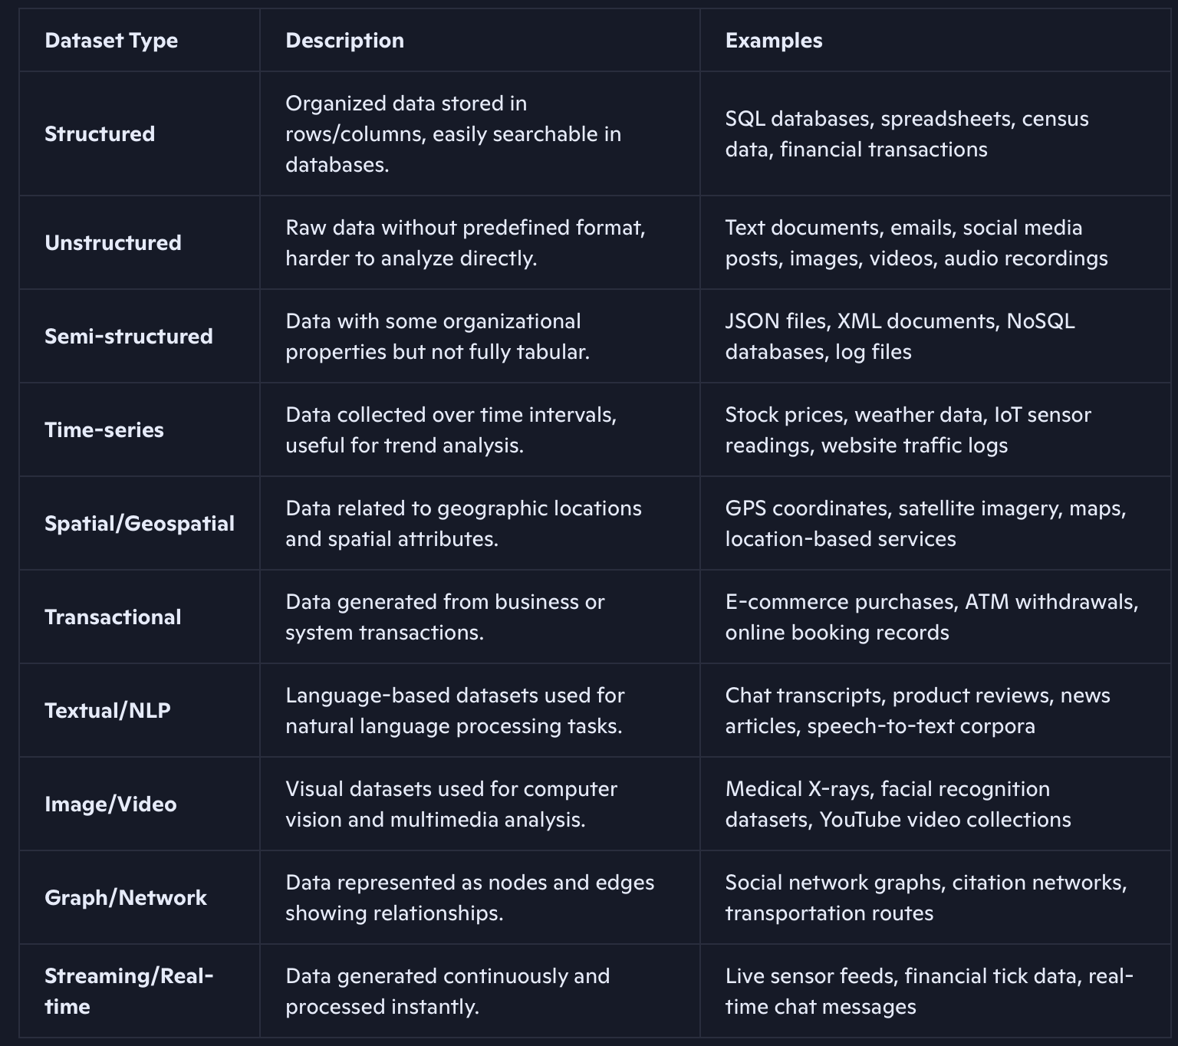

Slide 7
Challenges in Verification
Schema drift in databases
Inconsistent formats across systems
Missing or corrupted values
High volume & velocity in streaming data

Slide 8
Mathematical Tools Overview
Set Theory: Uniqueness, duplicates, intersections
Probability & Statistics: Outlier detection, distribution checks
Linear Algebra: Matrix consistency in multidimensional data
Graph Theory: Relationship validation in networks
Number Theory & Hashing: Checksums, file integrity

Slide 9

Set Theory in Action
Verify unique IDs across systems
Detect duplicates in transaction logs
Example: Ensuring employee IDs are not repeated

Slide 10

Probability & Statistics
Spot anomalies in server response times
Hypothesis testing for data quality
Example: Detecting abnormal login attempts

Slide 11
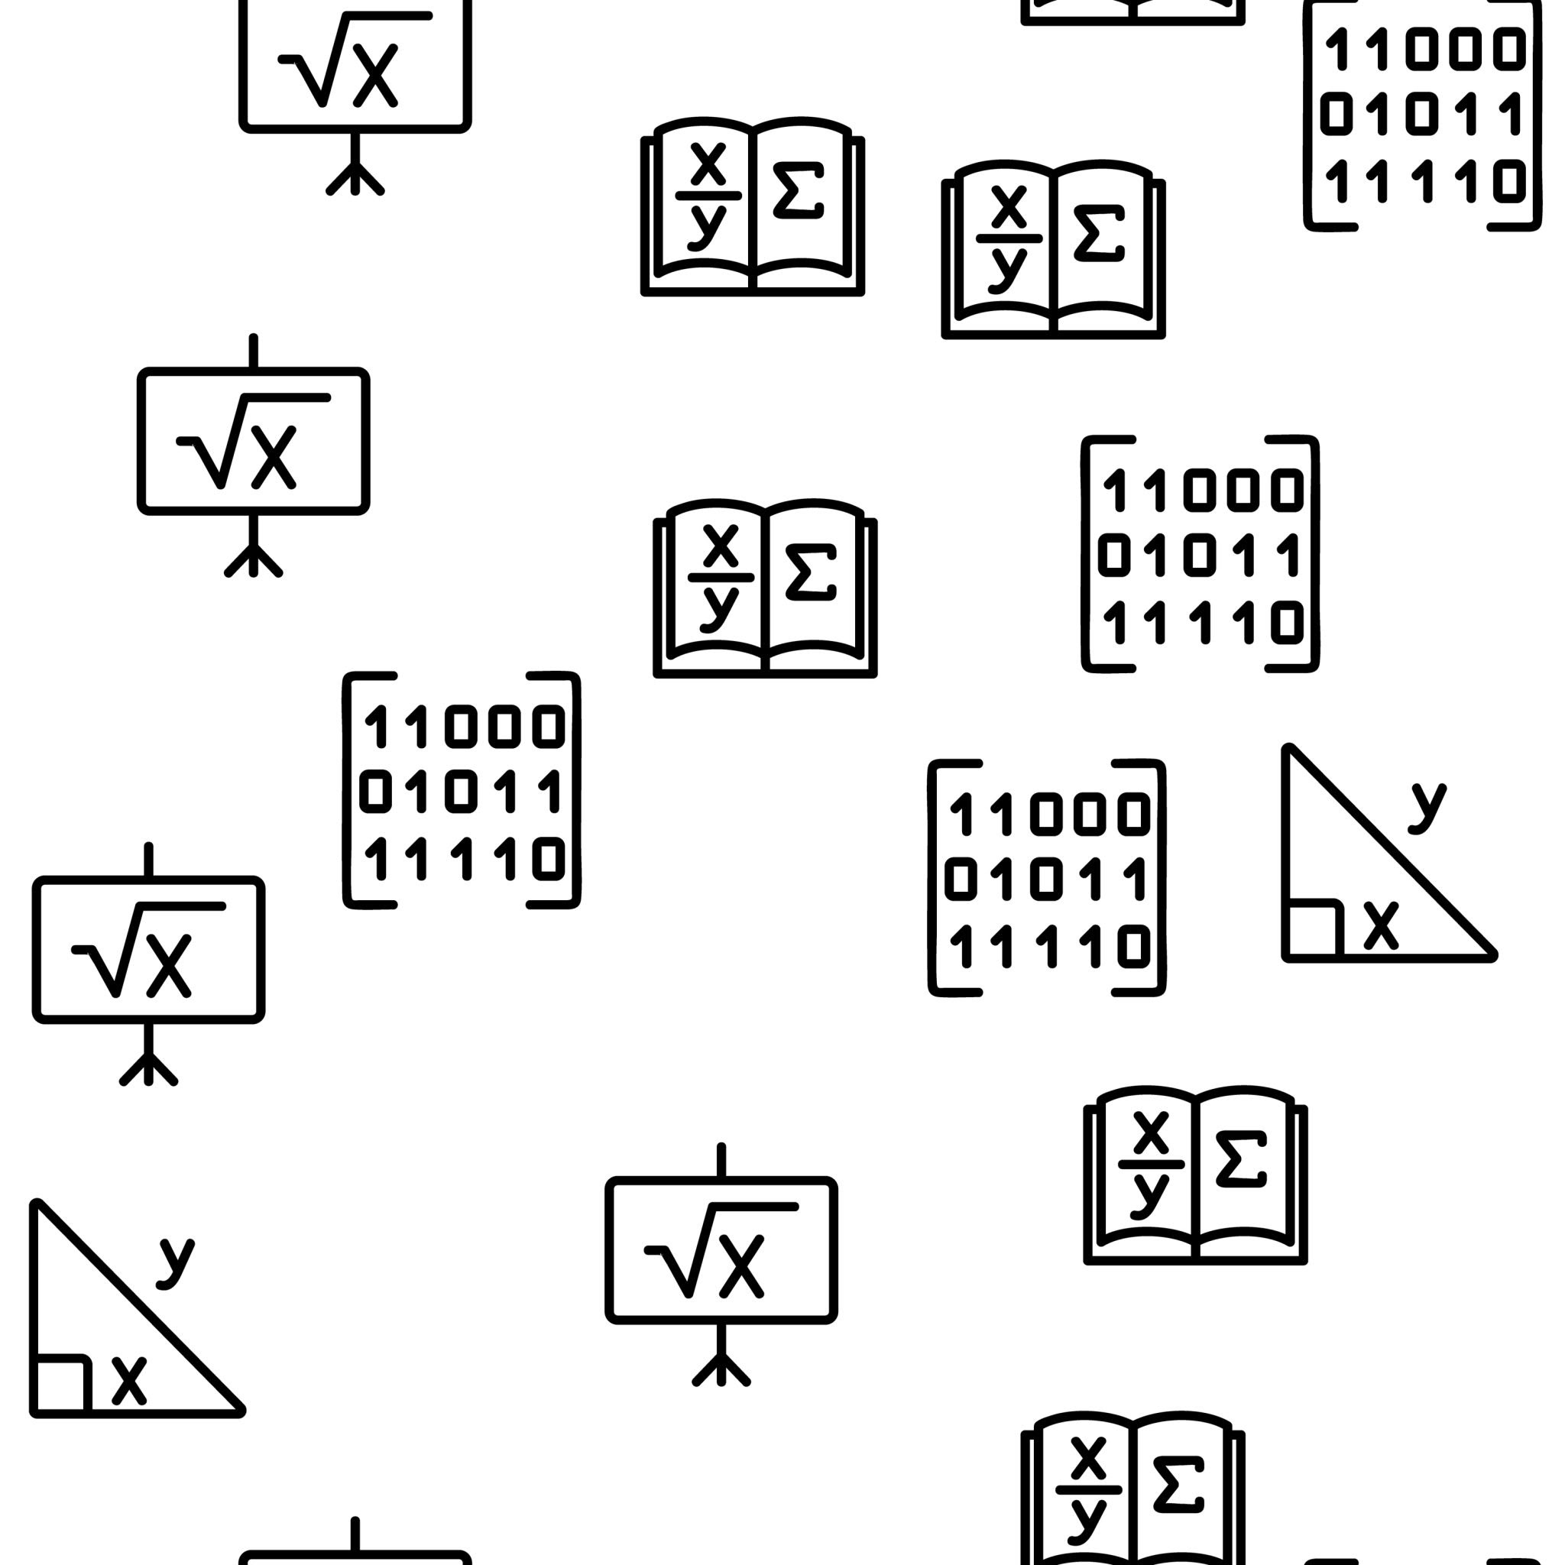
Linear Algebra Applications
Validate embeddings in ML pipelines
Check consistency in multidimensional datasets
Example: Image recognition vectors

Slide 12

Graph Theory Applications
Verify relationships in social networks
Detect broken links in IT infrastructure
Example: Ensuring all nodes in a network are connected

Slide 13
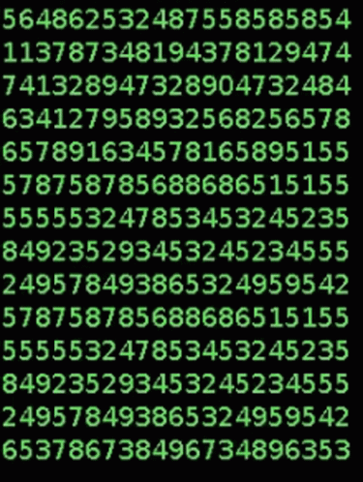
Hashing & Number Theory
Use checksums to detect corruption
Hash functions for file verification
Example: Verifying log files during transfer

Slide 14

Verification Techniques
Consistency checks (schema validation)
Redundancy checks (cross-source validation)
Error detection codes (parity, CRC)
Sampling & hypothesis testing

Slide 15
Hands - ON

Slide 16



Key Takeaways
Mathematical rigor ensures trust in IT data
Different datasets need different verification approaches
Automation + math = scalable solutions

Slide 17
Conclusion
Summarize:
Set theory → uniqueness
Statistics → anomalies
Linear algebra → consistency
Graph theory → connectivity
Hashing → integrity

Slide 18
Ingestion of Data from various Data-points

Slide 19
Introduction
Importance of data ingestion in ML/AI workflows
Explosion of heterogeneous data sources (structured, semi‑structured, unstructured)
Framing: “Without reliable ingestion, downstream ML models fail”

Slide 20
Types of Data Sources
Databases (SQL, NoSQL)
Streaming sources (IoT sensors, logs, clickstreams)
APIs & SaaS platforms (social media, CRM, ERP)
Files & cloud storage (CSV, JSON, S3, GCS)
Enterprise systems (transactional, operational)

Slide 21
Ingestion Paradigms
Batch ingestion: scheduled ETL jobs, nightly loads
Real‑time ingestion: Kafka, Flink, Spark Streaming
Hybrid approaches: Lambda vs Kappa architectures
Trade‑offs: latency vs cost, consistency vs availability

Slide 22
Architectures & Tools
ETL vs ELT — when to transform before vs after loading
Data lakes vs warehouses — ingestion implications
Tools: Apache NiFi, Airbyte, Fivetran, Kafka, Pulsar, Kinesis
Patterns: schema registry, CDC (Change Data Capture), event sourcing

Slide 23
Hands - ON

Slide 24
Future Trends
Data mesh and federated ingestion
AI‑driven pipeline optimization (self‑healing ingestion)
Edge ingestion for IoT/5G
Privacy‑preserving ingestion (federated learning, synthetic data)

Slide 25
Choosing a Model

Slide 26
Model choice = balancing practicality with performance

Slide 27
Problem Framing
Define task: classification, regression, generative
Structured vs. unstructured data
Clarify business objective before model choice

Slide 28
Data Characteristics
Volume, dimensionality, sparsity, noise
Labeled vs. unlabeled data availability
Data quality drives model effectiveness

Slide 29
Performance Metrics
Accuracy, precision, recall, F1, ROC-AUC
Business-aligned metrics (cost savings, churn reduction)
Choose metrics that reflect real-world impact

Slide 30
Interpretability vs. Complexity
Simple models = transparency (linear/logistic regression)
Complex models = higher accuracy, lower explainability (deep learning)
Trade-off depends on regulatory & business needs

Slide 31
Computational Constraints
Training time & inference latency
Hardware requirements (CPU/GPU/TPU)
Cost vs. scalability considerations

Slide 32
Deployment Environment
Edge vs. cloud deployment
Real-time vs. batch processing
Integration with existing systems

Slide 33
Model Families Overview
Regression: baseline, interpretable
Decision Trees/Random Forests: robust, feature importance
Gradient Boosting: high accuracy on tabular data
Neural Networks: best for unstructured data
Pre-trained Models: leverage transfer learning

Slide 34
Decision Framework
Start simple and benchmark baseline
Iterate to add complexity only if needed
Evaluate trade-offs: accuracy vs. interpretability, latency vs. throughput
Fine-tune pre-trained models when possible

Slide 35
Conclusion
Choosing a model = finding the right fit, not the fanciest algorithm
Decision-making mindset > checklist of algorithms
Align model choice with data, constraints, and goals

Slide 36
Implementing model with best practice

Slide 37
Problem Framing & Business Alignment
Translate KPIs into quantifiable ML objectives (precision@k, AUC, RMSE).
Decision-centric modeling: design models for how predictions will be consumed.
Apply cost-sensitive learning when misclassification costs differ.
Always benchmark against baseline models (logistic regression, linear regression).

Slide 38
Data Engineering & Feature Management
Data Versioning: DVC, Delta Lake for reproducibility.
Feature Stores: Feast, Tecton to avoid training-serving skew.
Bias & Fairness Audits: statistical parity, disparate impact ratio, SHAP fairness checks.
Synthetic Data: GANs or simulation for rare-event augmentation.
Best Practice: Document feature lineage and transformations.

Slide 39
Model Development & Hyperparameter Tuning
Learning Rate (η):
Too high → divergence; too low → slow convergence.
Best practice: use schedules (cosine annealing, warm restarts).
Batch Size:
Small → better generalization, noisy gradients.
Large → faster training, risk of poor minima.

Slide 40
Regularization:
L1 → sparsity; L2 → stability.
Dropout (0.2–0.5 typical).
Tree Models:
Max depth controls overfitting.
Min samples per leaf ensures generalization.

Slide 41
Neural Nets:
Start small, scale up.
Use ReLU for hidden layers, softmax/sigmoid for output.
Optimization:
Grid search, random search, Bayesian optimization.
Track experiments with MLflow, Weights & Biases.

Slide 42
Validation & Threshold Setting
Classification Thresholds:
Default = 0.5, but adjust based on business cost.
Fraud detection → lower threshold for higher recall.
Use ROC/PR curves to select optimal threshold.
Regression Acceptability:
Define domain-specific error tolerance (±5% in forecasting).
Metrics: RMSE, MAE, MAPE.

Slide 43
Fairness Thresholds:
Subgroup performance deviation ≤ 5–10% from overall.
Cross-Validation:
Stratified K-fold for imbalanced data.
Rolling window CV for time-series.

Slide 44
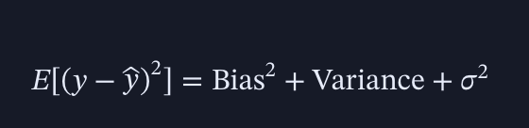
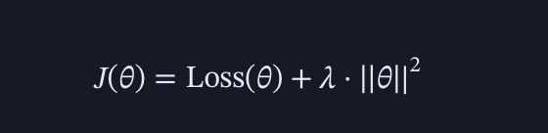
Mathematical Rules & Guidelines
Bias-Variance Tradeoff:
Regularization Principle:
Early Stopping: halt when validation loss plateaus.
Confidence Intervals: report uncertainty (95% CI).
Stress Testing: simulate distribution shifts (covariate, concept drift).

Slide 45
Deployment & MLOps
CI/CD for ML: automate pipelines with Kubeflow, Jenkins.
Containerization: Docker + Kubernetes.
Model Serving: REST APIs, gRPC, serverless functions.
Monitoring: latency, throughput, drift detection (EvidentlyAI, Fiddler).
Retraining Triggers: automate based on drift thresholds or performance decay.

Slide 46
Scaling & Performance
Distributed Training: Horovod, PyTorch DDP.
Model Compression: quantization, pruning, distillation.
Caching & Batching: optimize inference throughput.
Hardware Utilization: GPUs vs TPUs vs CPUs trade-offs.

Slide 47
Key Takeaways
Treat ML as a system, not just a model.
Hyperparameters must be tuned systematically.
Thresholds should align with business costs and risk tolerance.
Mathematical rules (bias-variance, regularization, CV) guide robust design.
Balance accuracy, interpretability, and fairness.
Continuous iteration = production-grade ML.

Slide 48
Overcoming Training issues

Slide 49
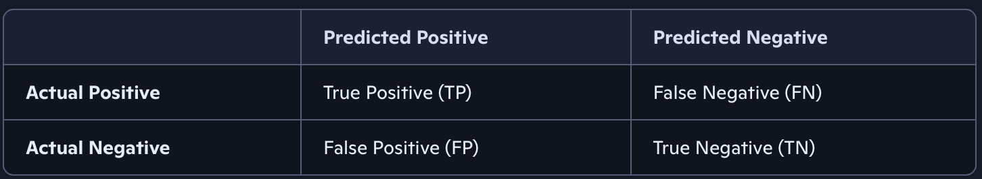
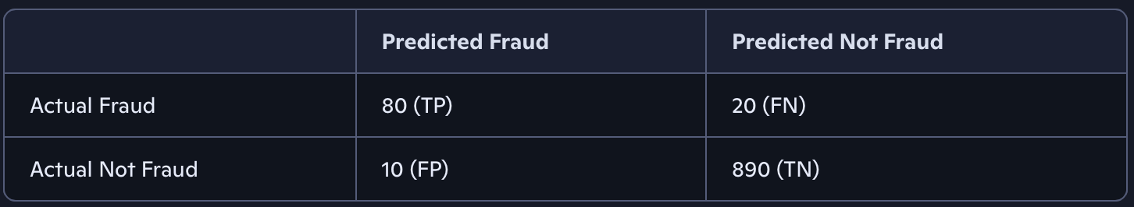
How to read Confusion Matrix

Slide 50
What can be derived
Accuracy: (TP+TN)/(Total)
Precision: TP/(TP+FP) → How many predicted frauds were actually fraud.
Recall (Sensitivity): TP/(TP+FN) → How many actual frauds were caught.
F1 Score: Harmonic mean of precision & recall.

Slide 51
Key Takeaway
Diagonal cells (TP, TN) → Correct predictions.
Off-diagonal cells (FP, FN) → Mistakes.
The balance between FP and FN matters depending on the application (e.g., fraud detection cares more about reducing FN).

Slide 52
Adding weak learning or strong learners selection techniques (Boosting and Bagging)

Slide 53
ensemble learning: combining multiple models to improve performance.

Slide 54
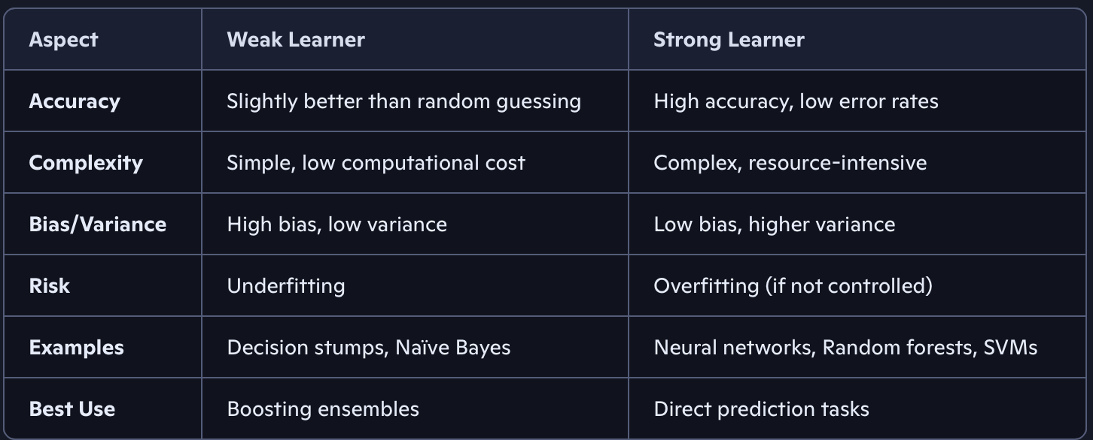

Slide 55
Bagging
Concept: Bootstrap Aggregating (Bagging) trains multiple models in parallel on random subsets of data.
Process:
Random sampling with replacement.
Train independent models (often decision trees).
Aggregate predictions (majority vote for classification, average for regression)

Slide 56
Strengths:
Reduces variance.
Prevents overfitting.
Example: Random Forest (bagging applied to decision trees).

Slide 57
Bagging
Concept: Sequentially trains models, each correcting errors of the previous one.
Process:
Start with a weak learner.
Assign higher weights to misclassified samples.
Train next learner to focus on those errors.
Combine learners with weighted voting.

Slide 58
Strengths:
Reduces bias.
Builds highly accurate models.
Risks: Can overfit if not regularized.
Examples: AdaBoost, Gradient Boosting, XGBoost, LightGBM.

Slide 59
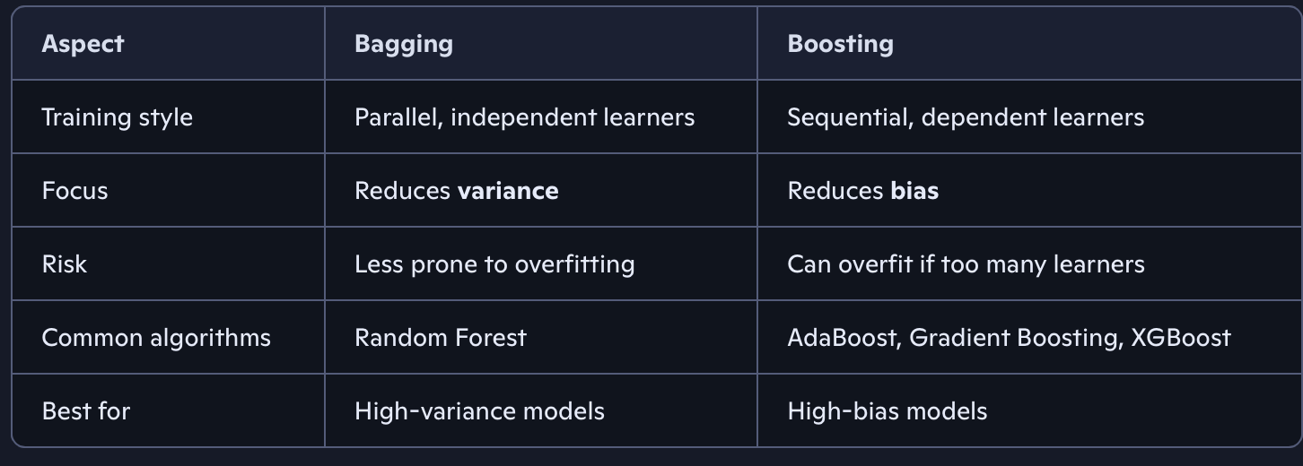

Slide 60
Hands - ON

